Slide 1
QUIZ MASTERS
B. Rithika- 88
G. Suma Sri- 116

Slide 2
Actors with use cases
User Admin
Register the name • Register the name
Login/Signup • Help
Start quiz • Feedback
End quiz
Score
Help
Feedback
Quit

Slide 3
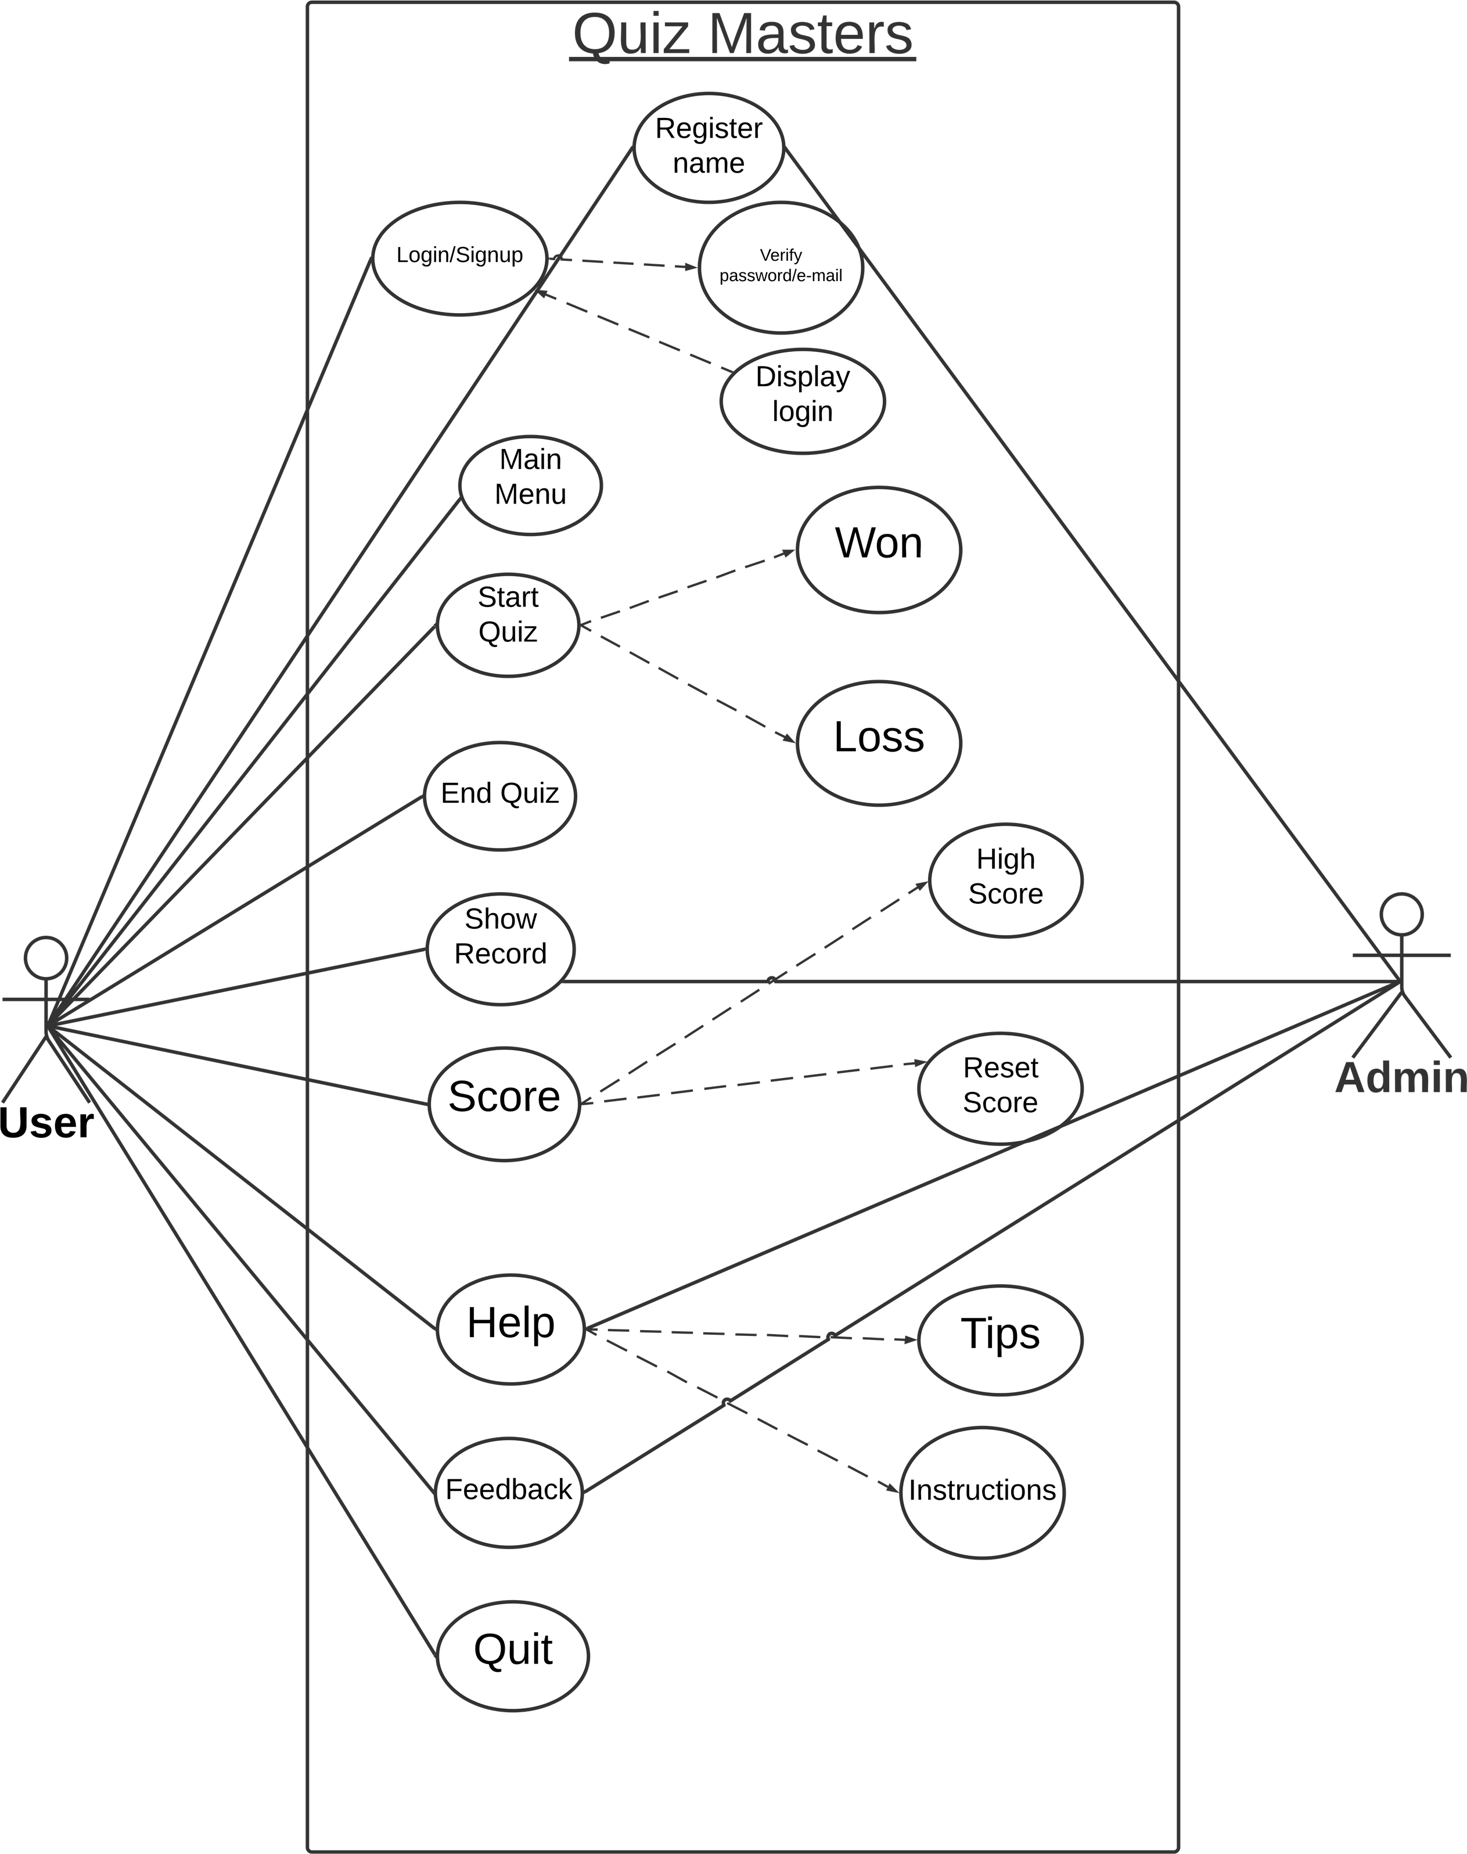
Use Case Design:

Slide 4
Use Case Descriptions:
Use case ID: UC01
Name: Register
Actors: User, Admin
Description: Allow new user to register for quiz with their name.
Pre- condition: None
Post-condition: allow the user to create an new account or to login
Main Flow:
User | System
1. Choose the register option
 | 2. Prompts for the data required for registration
3. Enter the data prompted by the user
 | 4. Validates user information If the information is valid, create an new account and take to next procedure.

Slide 5
Use case ID: UC02
Name: Login/signup
Actor: User
Description: Allows registered user to login/signup
Pre conditions: User should be registered with the quiz
Post conditions: User logs in and all options are displayed on screen.
Main flow:
User | System
1. Enter username and password and chooses the login option
 | 2. Validates username and password If username is invalid, display error message and prompt for valid password. If the password is invalid, display error message. If username and password are valid then display and login.

Slide 6
Use case ID: UC03
Name: start the quiz
Actors: User
Description: Allow registered user to start the quiz.
Pre conditions: User should be successfully registered and signed in to the quiz.
Post conditions: Questions are displayed to write the quiz
Main flow:
User | System
1. Select the start option
 | 2. Answer the questions displayed on the screen
3. Complete the quiz without getting back

Slide 7
Use case ID: UC04
Name: End the quiz
Actors: user
Description: Allows the registered user to end the quiz
Pre conditions: user should be successfully signed in and need to attempt the quiz
Post conditions: Quiz will come to the end
Main flow:
User | System
1. Select the end option to end the quiz
 | 2. Requests the admin to end the quiz, if the admin accepts the request, users answers will be checked, if they are right or wrong.

Slide 8
Use case ID: UC05
Name: Score
Actors: User
Description: Allows the registered user to know the score of the quiz
Pre conditions: User should be successfully signed in and need to attempt the quiz and end the quiz
Post conditions: User will be done with quiz and can able to know the score.
Main flow:
User | System
1. Select the option called score
 | 2. Checks the given answers are correct or wrong and displays the score. After knowing the scores, user can get what are the correct answers User can now reset the score User can also view the highest scores and can know the others highest scores

Slide 9
Use case ID: UC06
Name: Show record
Actors: User, admin
Description: Allows the registered user to get to know about their previous scores and present ones.
Pre conditions: User should be successfully signed in and need to select the particular options
Post conditions: User gets all the other options to know about his previous quiz records.
Main flow:
User | System
1. Selects the option of show the record
 | 2. Requests the admin to show the record, if admin accepts the request user can see the record. After selecting the suitable option, user can able to view their previous and present scores of his attempted quizzes. User can also reset and view his highest scores of his no of quizzes , he attempted.

Slide 10
Use case ID: UC07
Name: Help
Actors: User
Description: Allows the registered user to know about the instructions of quiz masters
Pre conditions: User should be successfully signed in and need to select the help option.
Post conditions: User gets all the instructions about the quiz about what he couldn’t understand.
Main flow:
User | System
1. Selects the option called help
 | 2.After selecting the help option User can get the instructions of quiz on, how to attempt it. Some tips will also be given to the user, if they had any difficulty in attempting the quiz.

Slide 11
THANK YOU

